Slide 1
Health care problem
-Vivek Dodia

Slide 2
The task is to analyze the clinical and financial data of patients hospitalized
I have solved this problem using python as a programming language.
Libraries used in this project are NumPy, Pandas and Matplotlib.
Step1: Read all the csv file .
Step2: Perform Exploratory Data Analysis
Step3: Data Cleaning
Step4: Data Visualisation using Matplotlib.

Slide 3
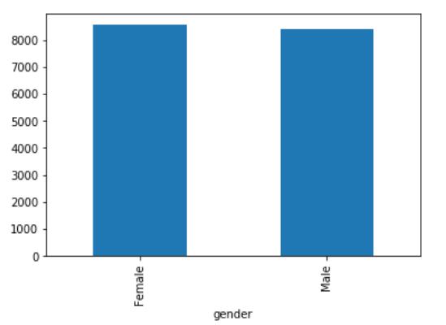
Graph 1: Gender V/S Patient Id
The number of patient in term of gender(i.e Male and Female) have almost similar count who have been hospitalised for certain condition.
Looking at the bar graph we can say that Female has higher number of patient as compared to Male.

Slide 4
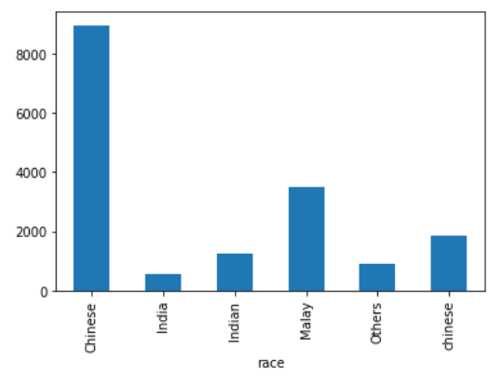
Graph 2: Race V/S Patient Id
The graph represent that Chinese and Malaysian people get more hospitalised due to certain diseases.
On the other hand Indian people and other’s Country people often get ill.

Slide 5
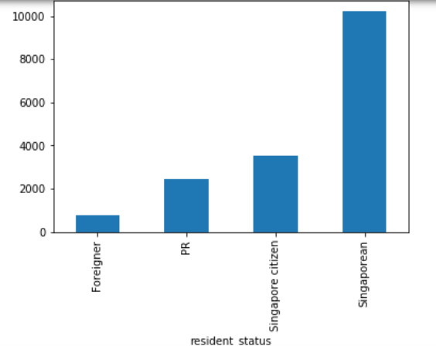
Graph 3: Resident Status V/S Patient Id
The Bar chart shows in which category of the people who live in Singapore gets hospitalised.
Singaporean people and citizen of Singapore has highest number of admitted in hospital compared to Foreigner and Permanent resident of Singapore.

Slide 6
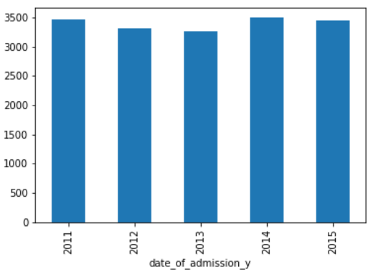
Graph 4: Admission Year V/S Patient Id
From this graph we can say that the number of patient in the year 2014 had the highest number of patient admitted.
In the year 2012 and 2013 had the least number of patient who got admitted.

Slide 7
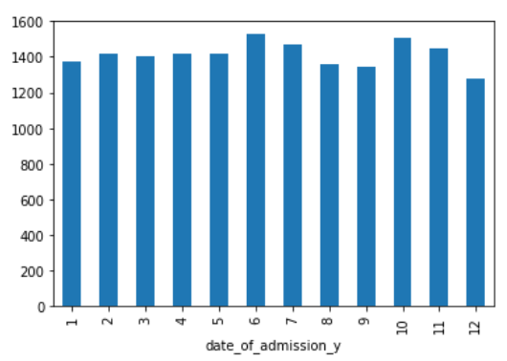
Graph 5: Admission Monthwise V/S Patient Id
In the month of July and October the people in the Singapore get admitted due to various reason as compared to other months.
There is less number of people who get ill due to various disease’s in the month of September and December.

Slide 8
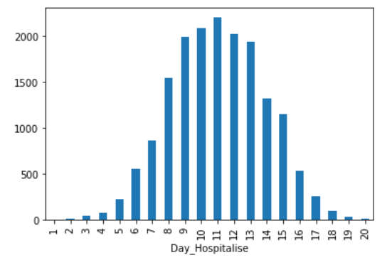
Graph 6: Total Number of Days Hospitalised V/S Patient Id
From this bar graph, we can conclude that the people who get admitted the get recovered in 8-14 days.
There are very few count of people who get recovered within 5 days.

Slide 9
Thank You

